Slide 1
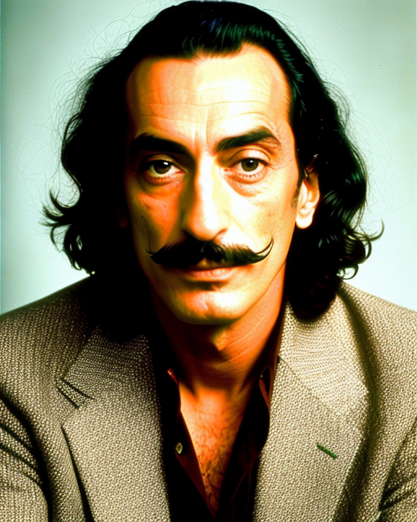
Romano Dalí
Northwell Health
Bio:
Born in Veneto, Italy. Emigrated to the U.S. to pursue a doctorate in medicine. Works in the field of Cardiology at Northwell as a Doctor.
Personal Data
Age: 57
Gender: Male
Occupation: Doctor
Location: Veneto, Italy
Goals
Learn to how to use Med-X
Read X-rays the right way
Make accurate diagnoses
Challenges
Misreading X-Rays due to poor image quality
Usually given limited time to read the X-rays
Poor visibility

Slide 2
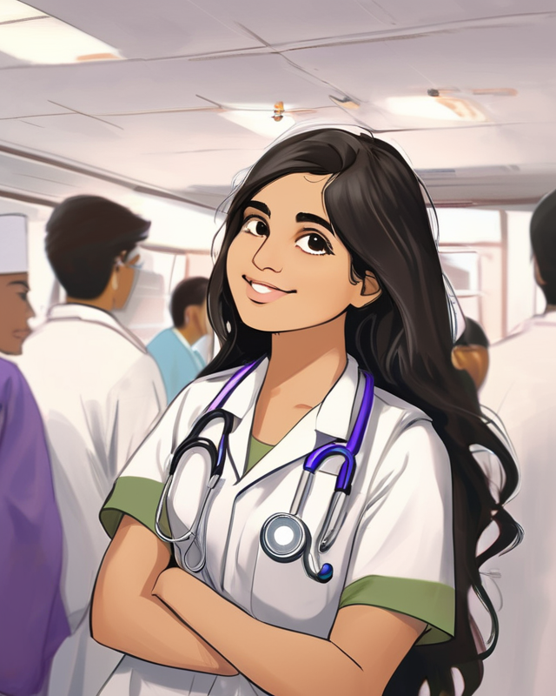
Siddhi Du
NYU Langone Medical Center
Bio:
A 22-year-old foreign exchange medical
Student from India. Joined NYU Langone for a part time internship during her studies
Personal Data
Age: 22
Gender: Female
Occupation: Doctor Intern
Location: Maharashtra, India
Goals
Use Med-X to facilitate her tasks
Complete her internship
Explain findings to patients in a clear manner
Challenges
Inexperienced with the process
Unaware of the different anatomies of the patients
Prone to a limited field of view

Slide 3
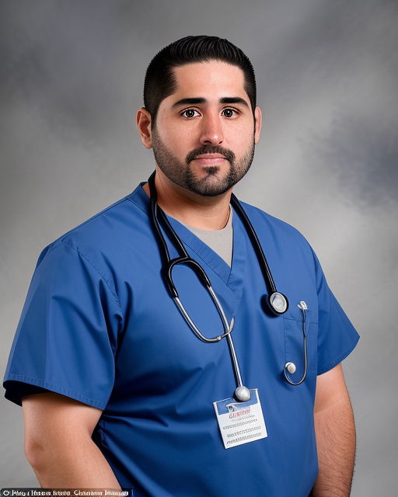
Bryce Ruiz
Albuquerque Medical Center
Bio:
A 34-year-old medical professional from Fresno. Has been working at Albuquerque for over 10 years and has recently been promoted to Cardiology to conduct X-Rays
Personal Data
Age: 34
Gender: Male
Occupation: Doctor
Location: Fresno, Ca
Goals
Find new ways to conduct X-Rays
Build a strong reputation within patients
Explain to patients what they have in a clear manner
Challenges
Not being able to understand traditional X-Rays
His patients come out confused about their diagnosis
Unfamiliar with the AI environment

